Slide 1
Prometheus & Graphana
Ankur Agrawal
April 7th, 2020

Slide 2
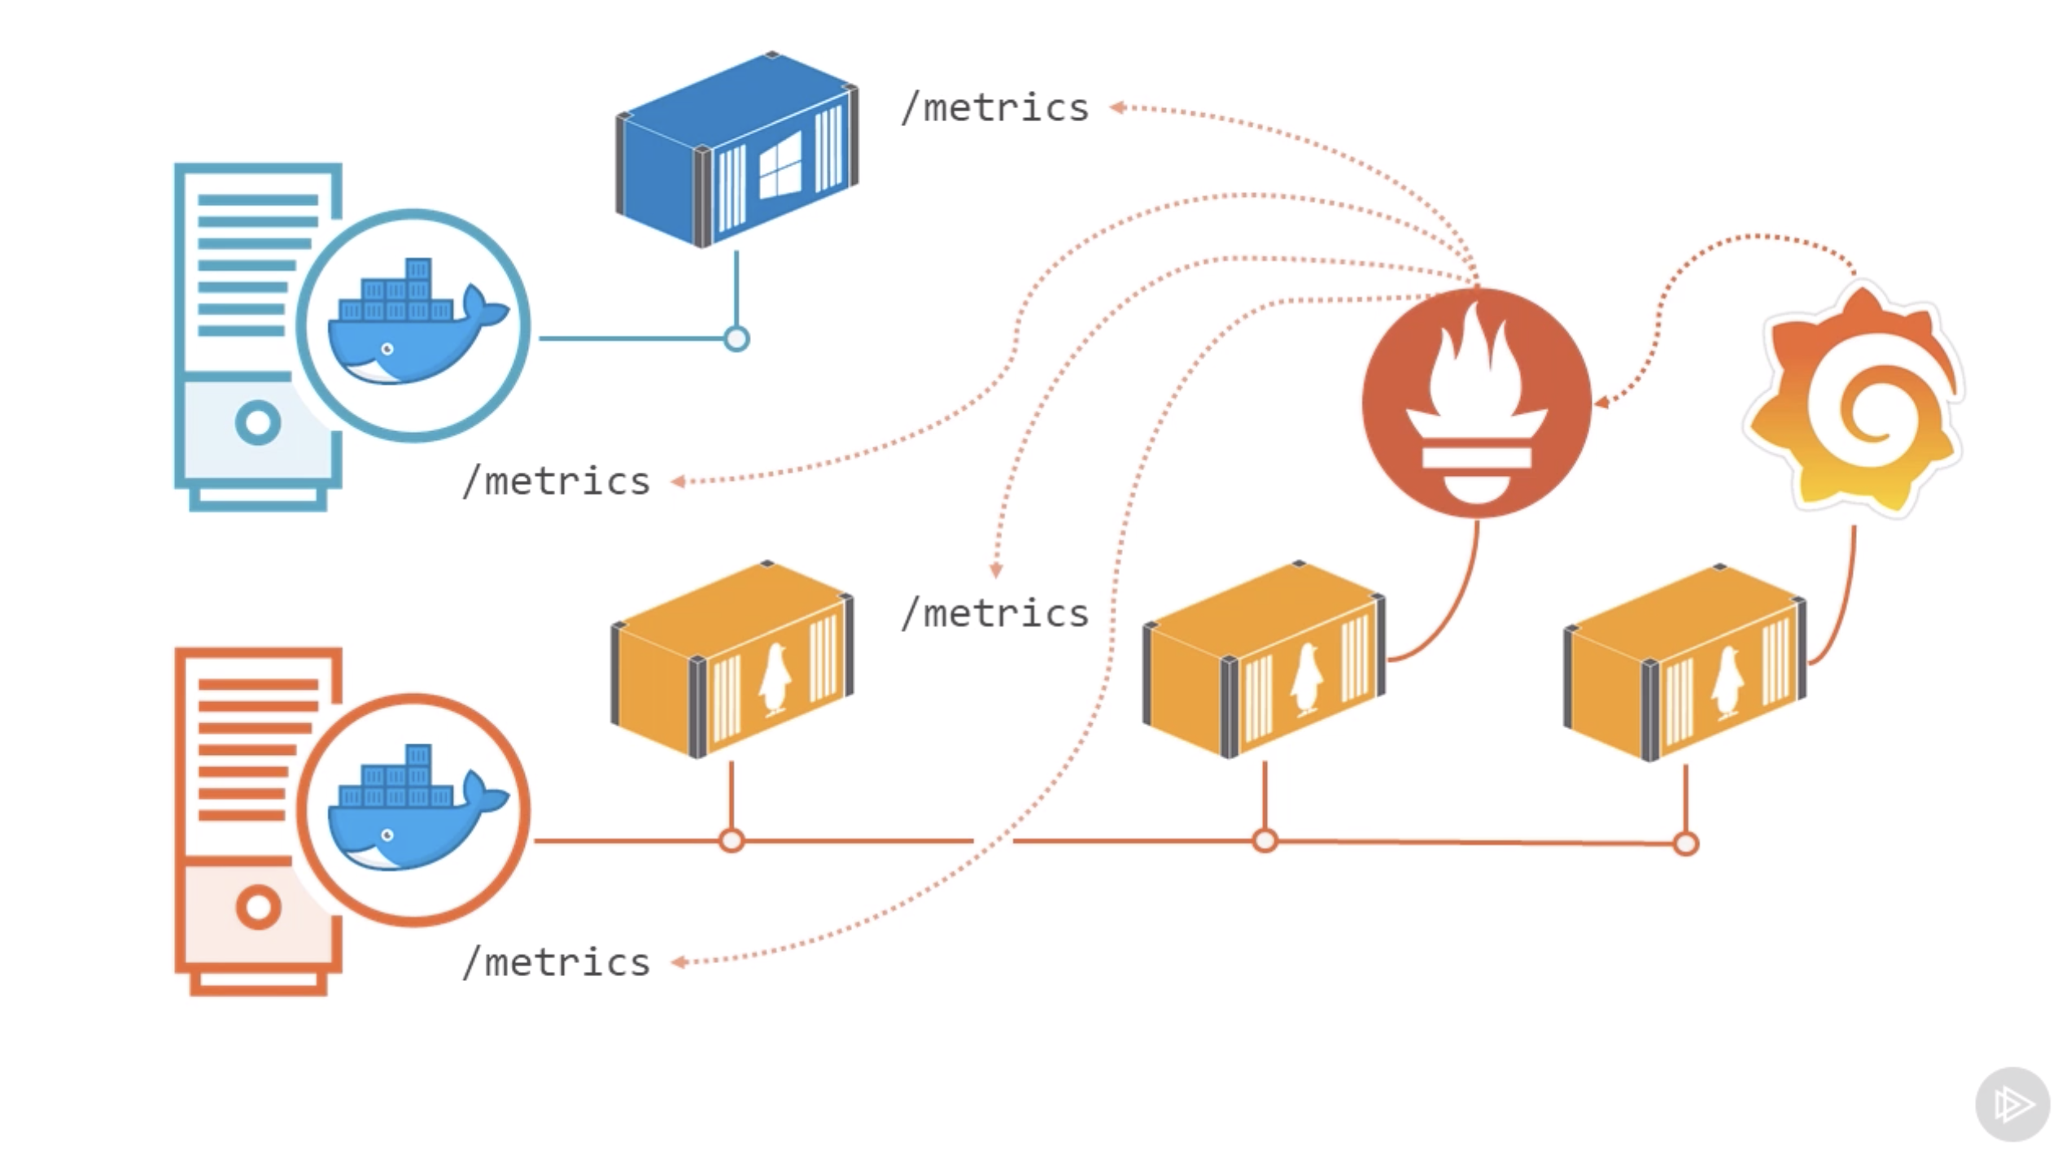

Slide 3

Prometheus

Slide 4
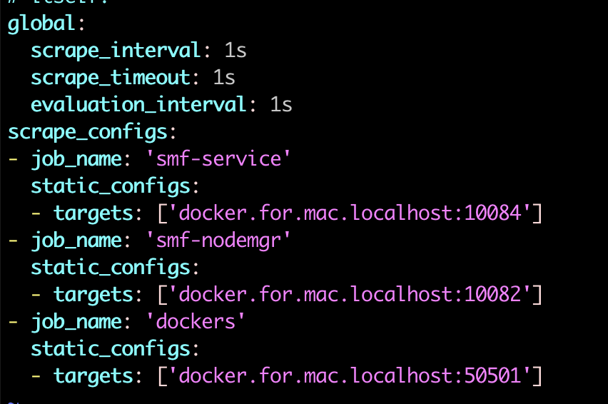
Docker Configuarion

Slide 5
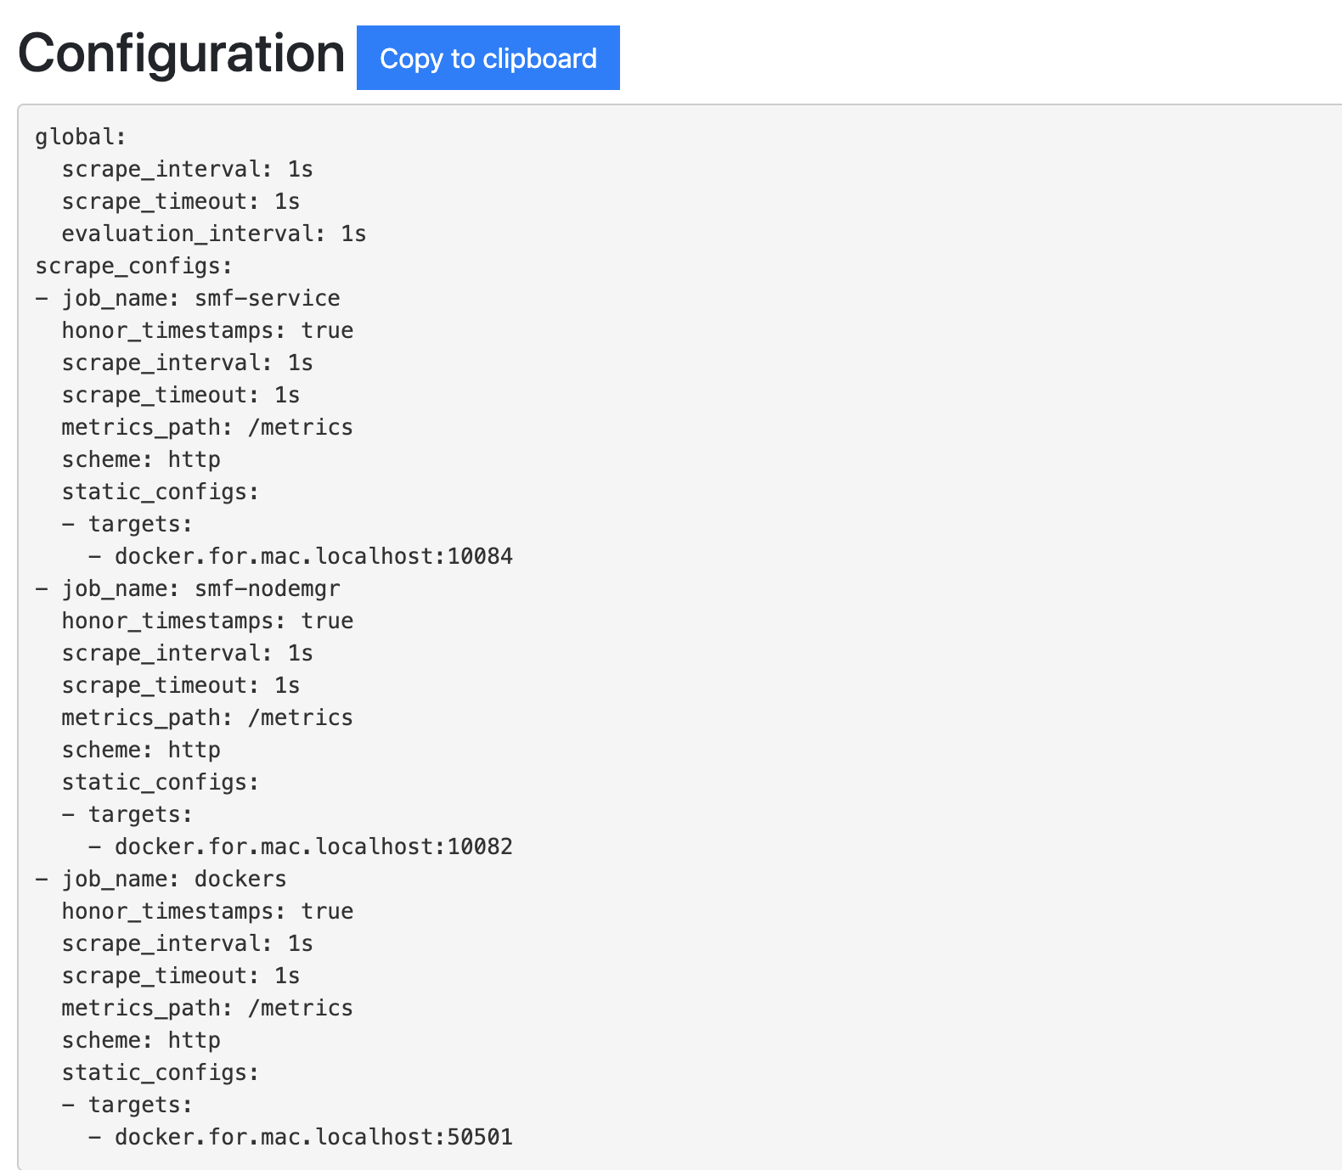
Configuration @Prometheus

Slide 6
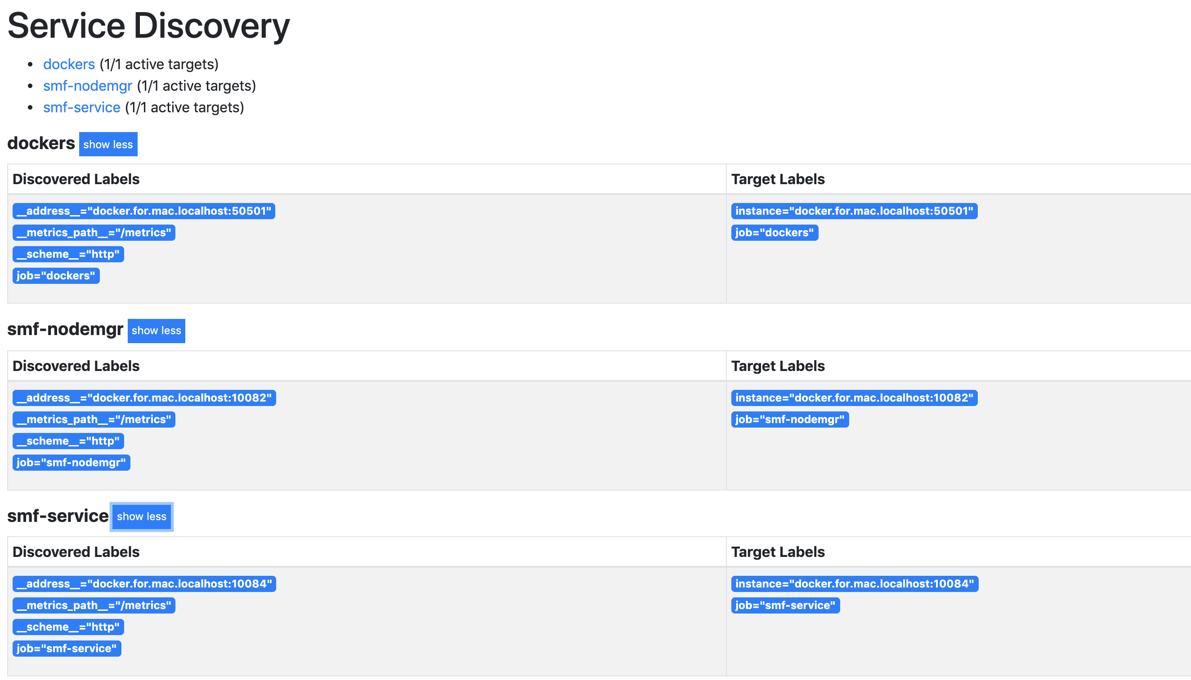

Slide 7
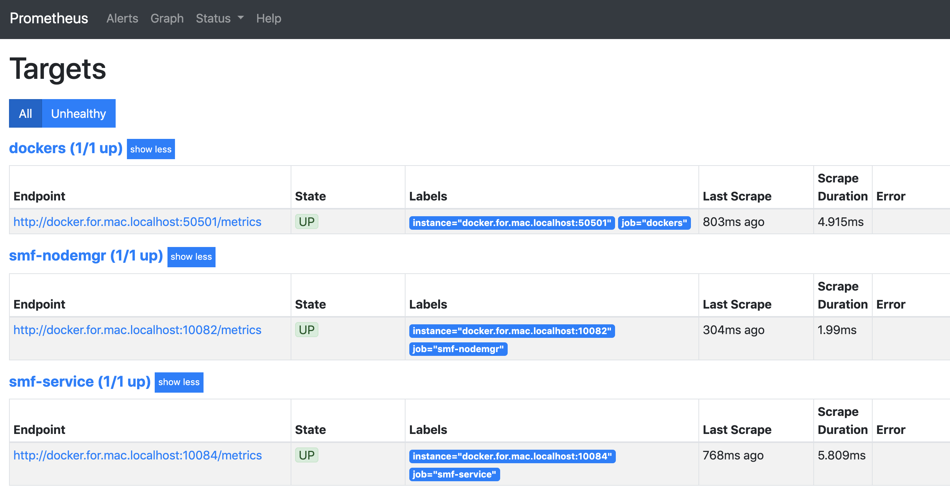

Slide 8
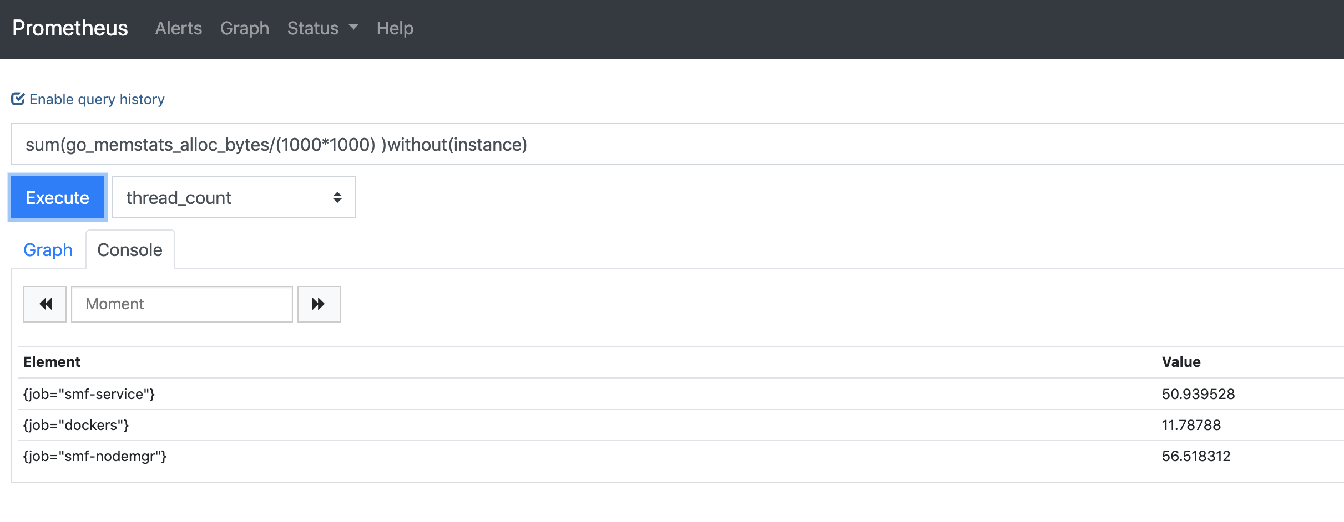
Metrics on console

Slide 9
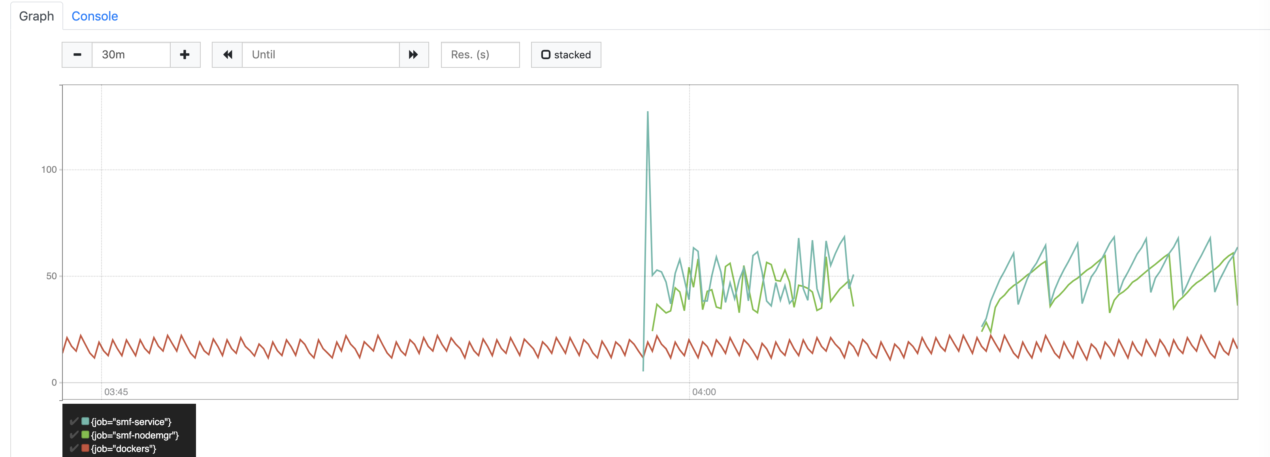
Metrics on Graph

Slide 10
Application Metrics

Slide 11
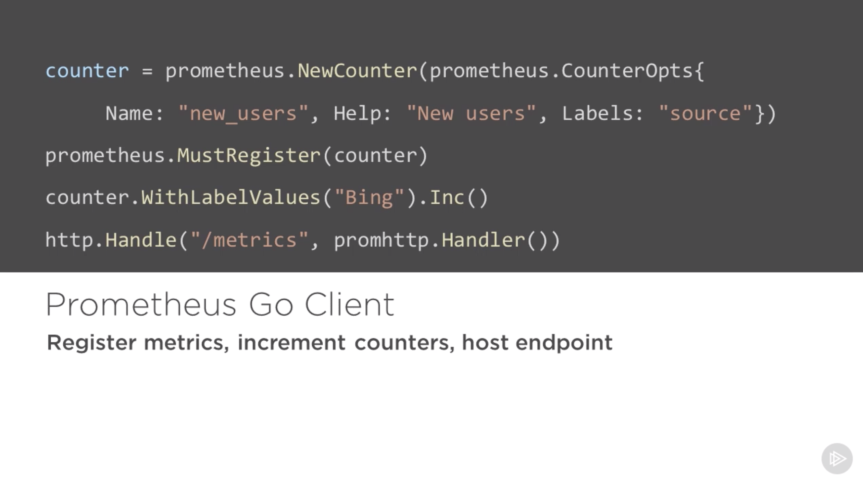

Slide 12
Docker Metrics

Slide 13
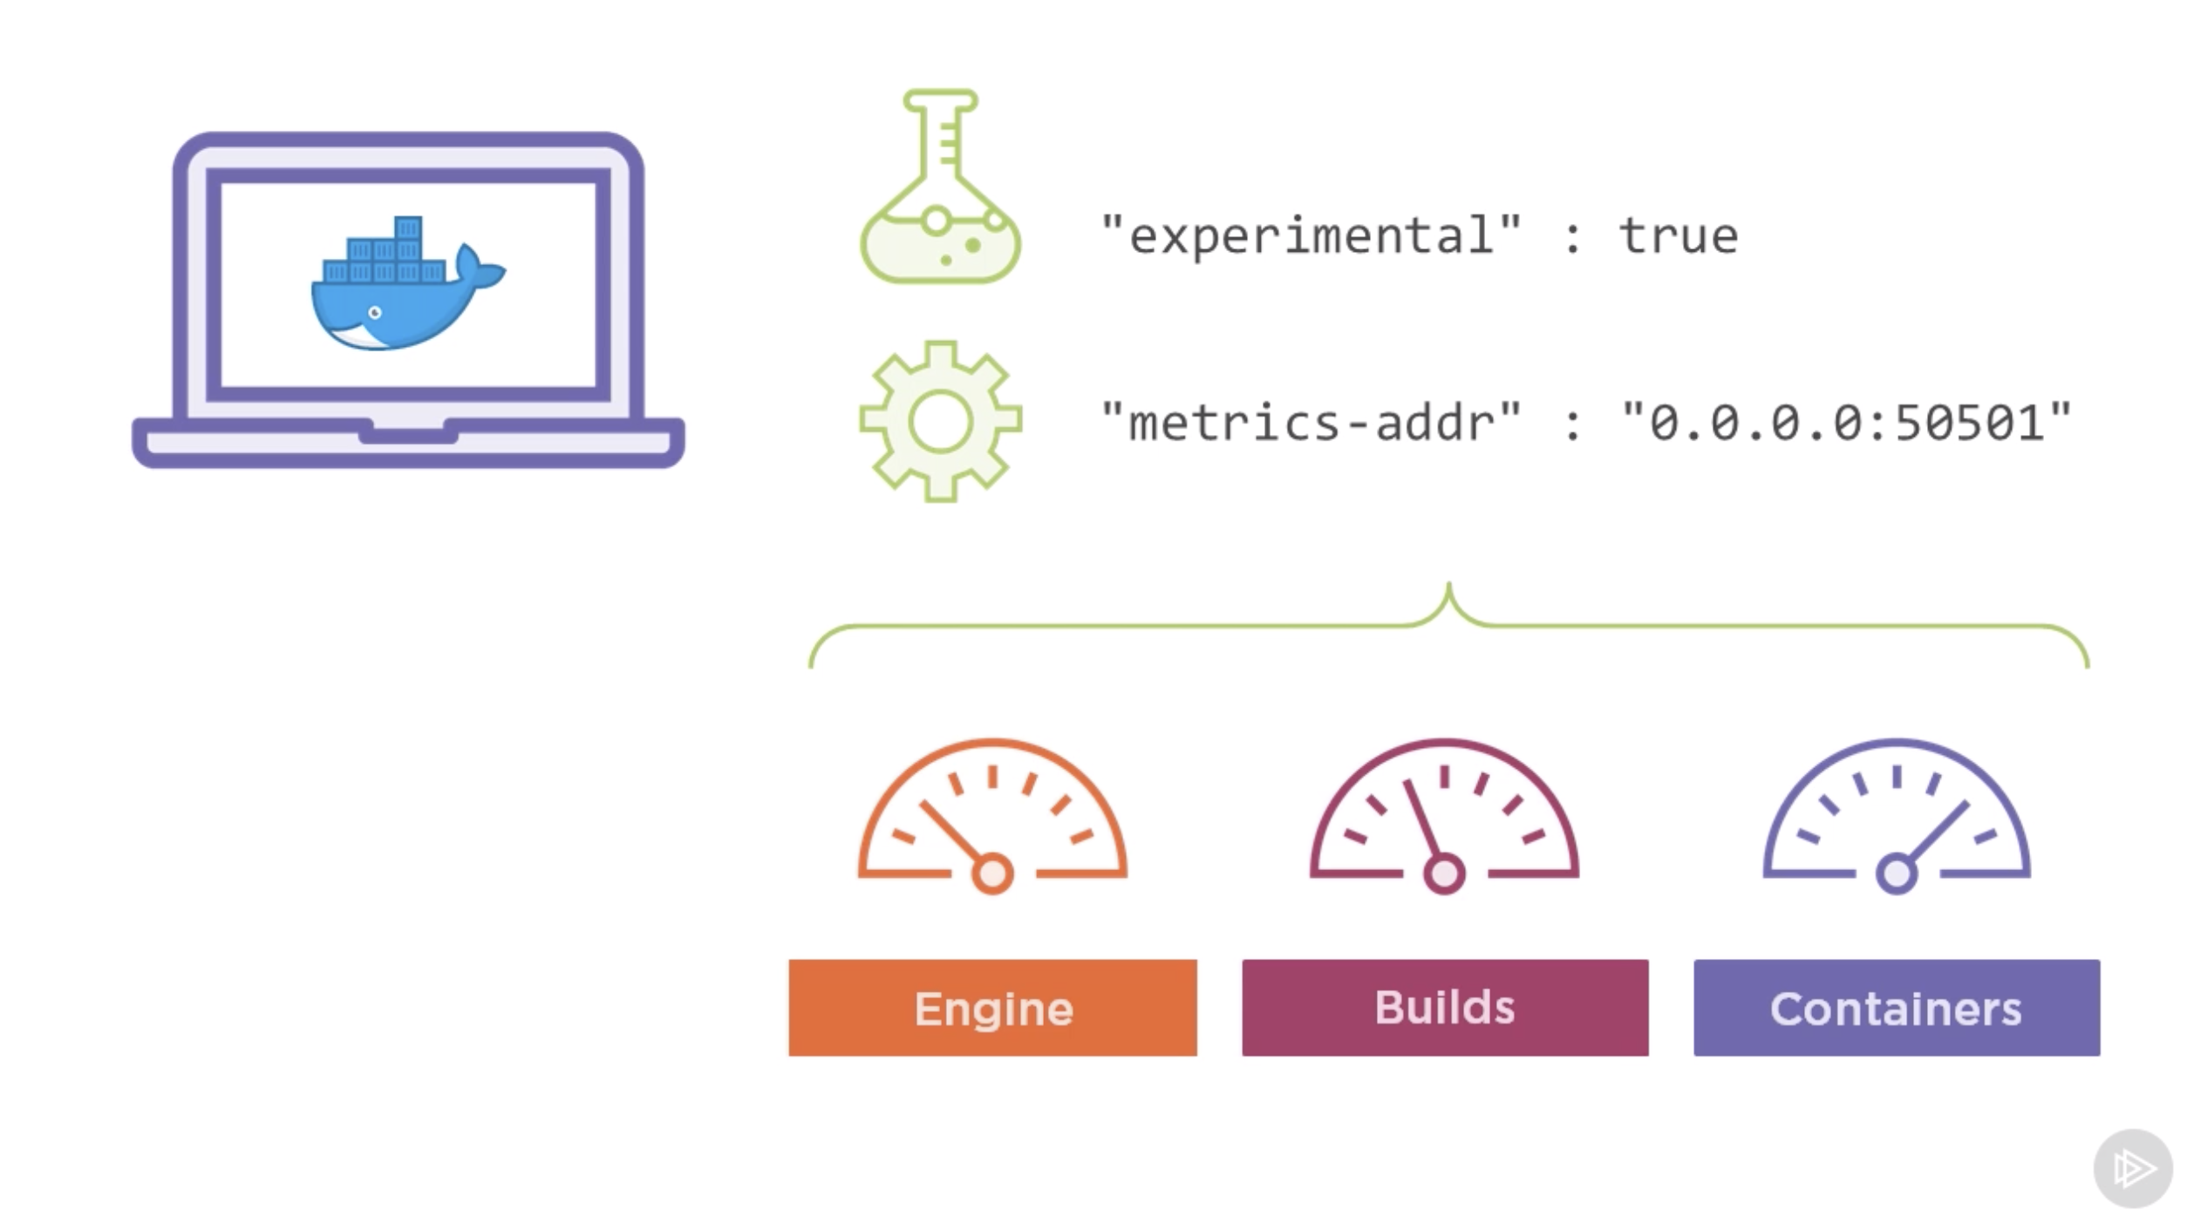
Charts

Slide 14
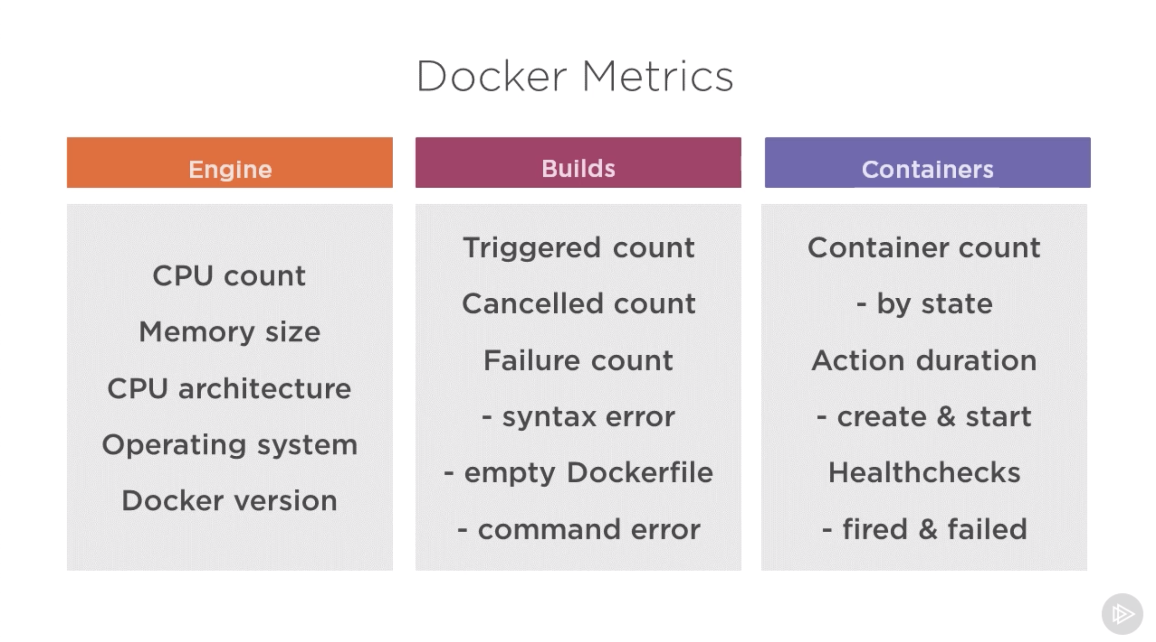

Slide 15
Thank You.

